Slide 1
FINANCIAL PORTFOLIO MANAGEMENT
SUBMITTED TO:
MR. HARPREET SINGH GILL
SUBMITTED BY:
VARUN NAGPAL
CS-C(G2)
16ESKCS177

Slide 2
CONTENTS
ABOUT THE COMPANY
INTRODUCTION
WHAT IS FINANCIAL PORTFOLIO
FINANCIAL PORTFOLIO MANAGEMENT
TECHNOLOGY AND TOOLS USED
DESIGN
CONCLUSION

Slide 3
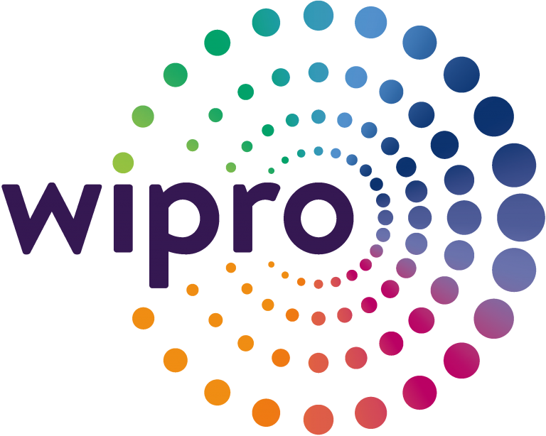
ABOUT THE COMPANY
WIPRO LTD.
Wipro Limited is a leading global information technology, consulting and business
process services company. It focus to harness the power of cognitive computing,
hyper-automation, robotics, cloud, analytics and emerging technologies to help the
clients adapt to the digital world and make them successful. A company recognized
globally for its comprehensive portfolio of services, strong commitment to
sustainability and good corporate citizenship, it has over 160,000 dedicated
employees serving clients across six continents.

Slide 4
WHAT IS FINANCIAL PORTFOLIO?
The term “financial portfolio” refers to any combination of financial assets such as stocks, bonds and cash.
Portfolios may be held by individual investors and/or managed by financial professionals, banks and other financial institutions.
An investment portfolio can be thought of like a pie that is divided into pieces of varying sizes, representing a variety of asset classes and/or types of investments.

Slide 5
FINANCIAL PORTFOLIO MANAGEMENT
“Financial Portfolio Management aims to provide users full information related to the stocks or shares purchased by them. User would be provided with comparison of prices between the date they invested and present day along with profit/loss info using graphical representation. Moreover, the user can also add the information about selling of shares which will calculate effective profit/loss.”

Slide 6
TECHNOLOGIES AND TOOLS USED
DJANGO FRAMEWORK
PostgreSQL DATABSE
PYTHON(3.7.x)
HTML5/CSS

Slide 7
DJANGO FRAMEWORK
Django is a high-level Python Web framework that encourages rapid development and clean, pragmatic design of web application.
Django is a Python-based free and open-source web framework, which follows the model-view-template architectural pattern.
It is maintained by the Django Software Foundation, an independent organization.
Django's primary goal is to ease the creation of complex, database-driven websites.
Latest stable release - 2.2.5

Slide 8
PostgreSQL
PostgreSQL, also known as Postgres, is a free and open-source relational database management system. It is designed to handle a range of workloads, from single machines to data warehouses or Web services with many concurrent users.
PostgreSQL runs on all major operating systems, including Linux and Windows.
PostgreSQL supports a large part of the SQL standard and offers many modern features including complex SQL queries, foreign keys, Trigger, views and many more.

Slide 9
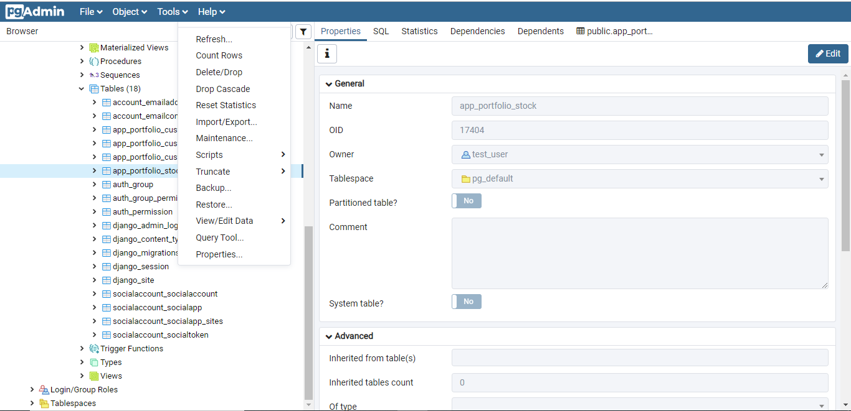

Slide 10
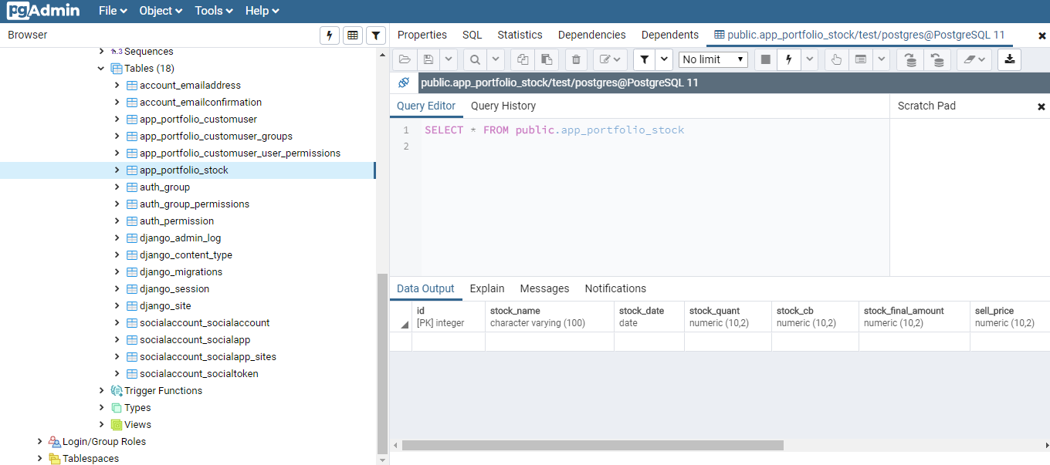

Slide 11
PYTHON(3.7.x)
Python is an interpreted, high-level, general-purpose programming language. You can use Python for developing desktop GUI applications, websites and web applications.
Also, Python, as a high level programming language, allows you to focus on core functionality of the application by taking care of common programming tasks.
Python works on different platforms (Windows, Mac, Linux, Raspberry Pi, etc.).
Python has a simple syntax similar to the English language. Python has syntax that allows developers to write programs with fewer lines than some other programming languages.
Python can be treated in an object-orientated way or a functional way.

Slide 12
HTML/CSS
HTML stands for Hyper Text Markup Language.
CSS stands for cascading style sheets.
HTML describes the structure of a Web page. It consists of a series of elements.
HTML elements tell the browser how to display the content. HTML elements are represented by tags. Browsers do not display the HTML tags, but use them to render the content of the page
CSS describes how HTML elements are to be displayed on screen, paper, or in other media.
CSS saves a lot of work. It can control the layout of multiple web pages all at once.

Slide 13
DESIGN OF THE PROPOSED SYSTEM

Slide 14
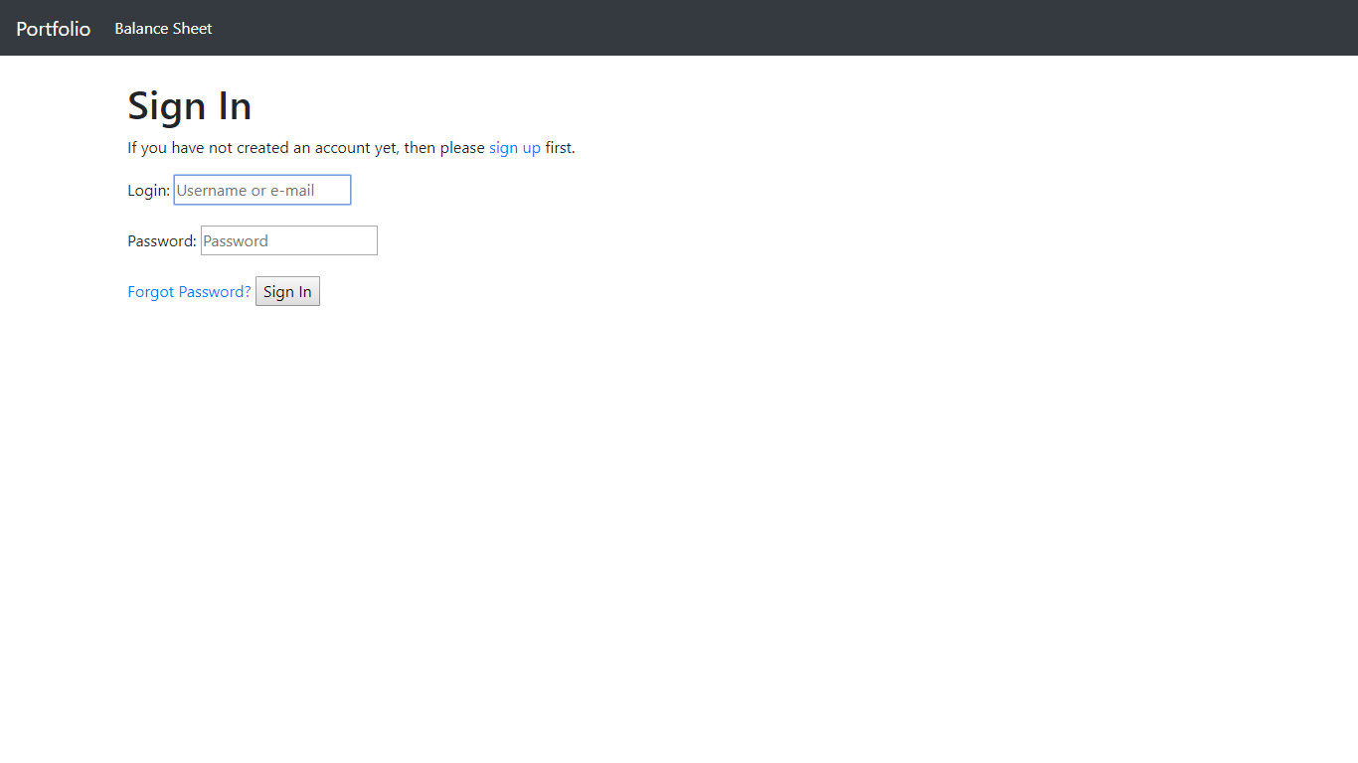

Slide 15
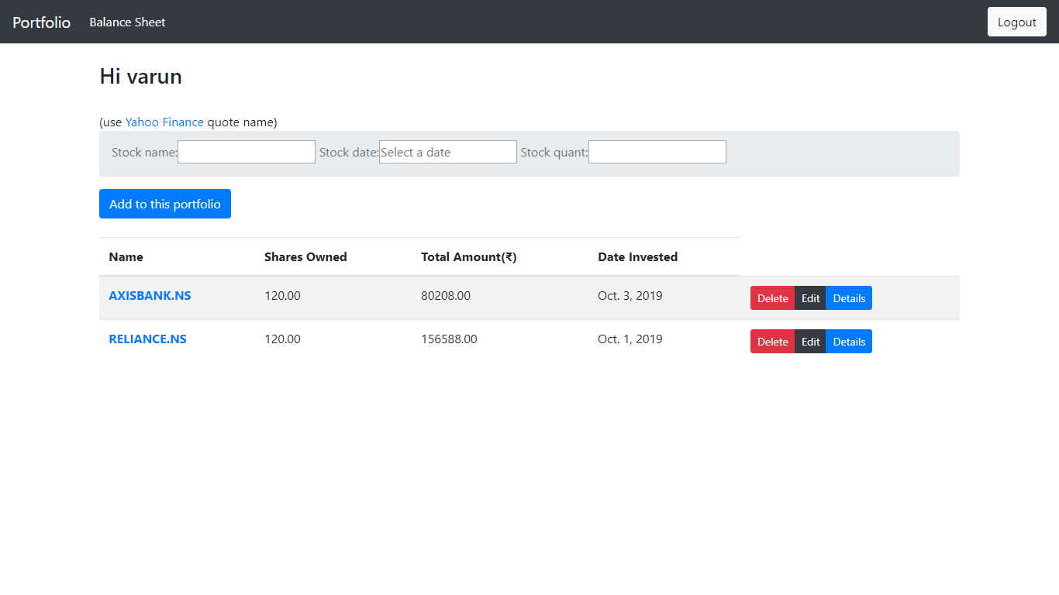

Slide 16
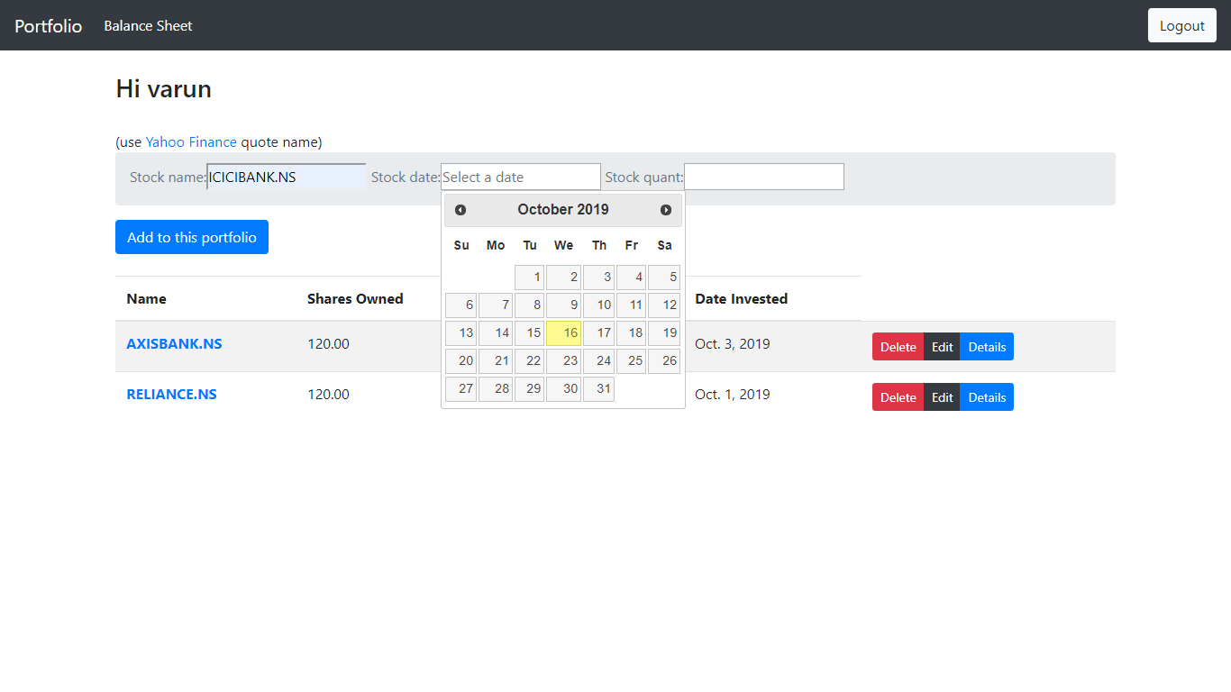

Slide 17
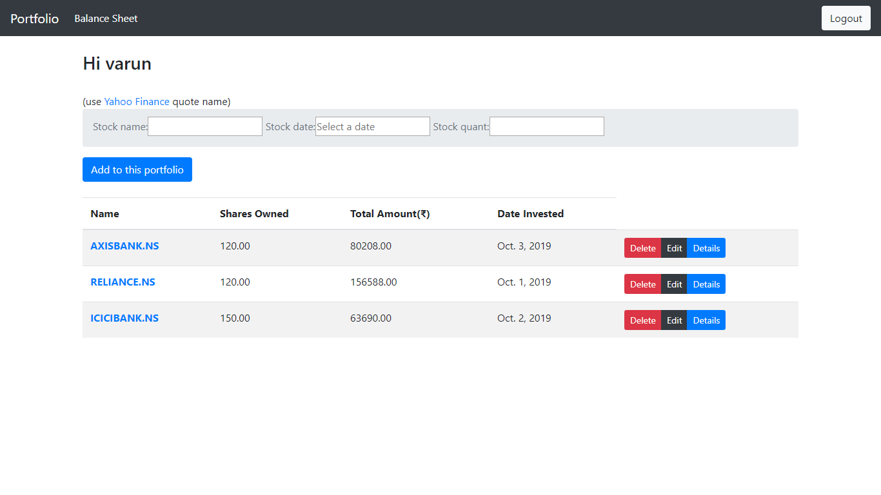

Slide 18
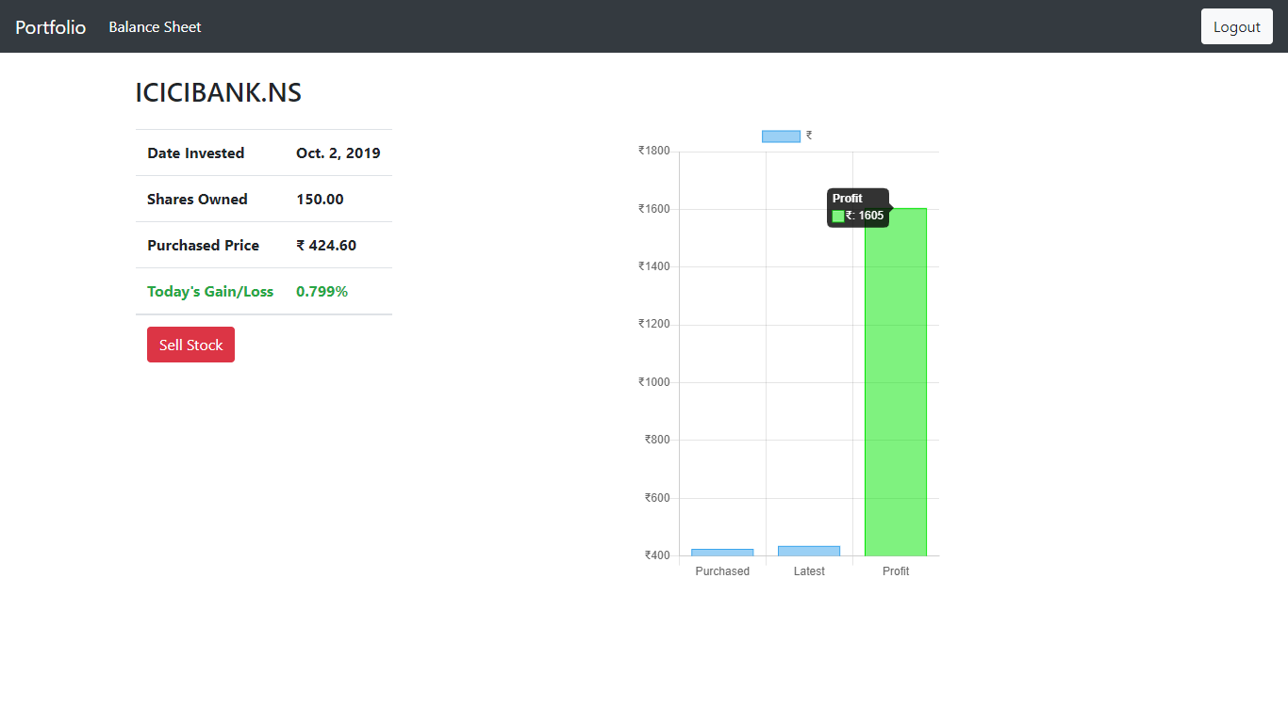

Slide 19
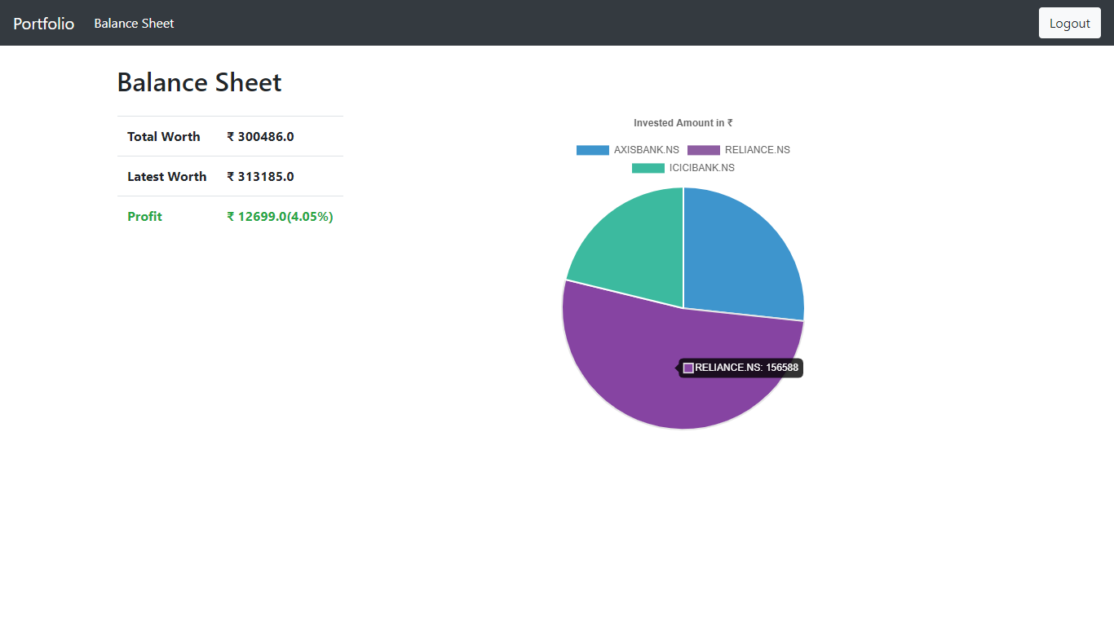

Slide 20
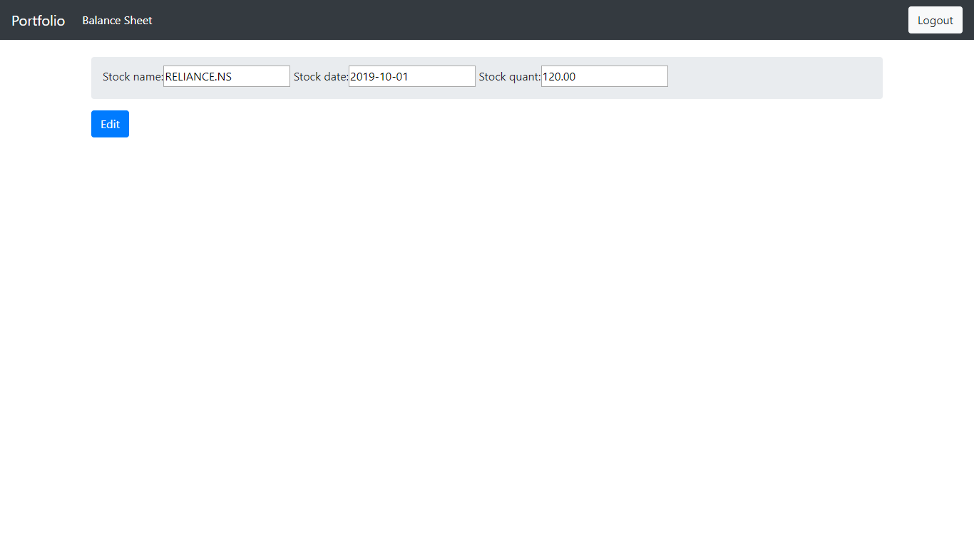

Slide 21
FUTURE SCOPE
Future scope is to provide following options to the users:
Cryptocurrency: Major scope is to add cryptocurrency in this web-app which allows user to add information regarding invested amount in cryptocurrency which is major demand of the market.
Better Frontend: Better looking UI along with mobile browser support.
Change/Forgot Password: Password change option and forgot password option to the user, along with various minimal changes such as currency conversion.

Slide 22
CONCLUSION
Financial Portfolio Management is a Web-App that can be used by any individual or organisation to manage the investments done by them in an organised way.

Slide 23
THANK YOU!

